Slide 1
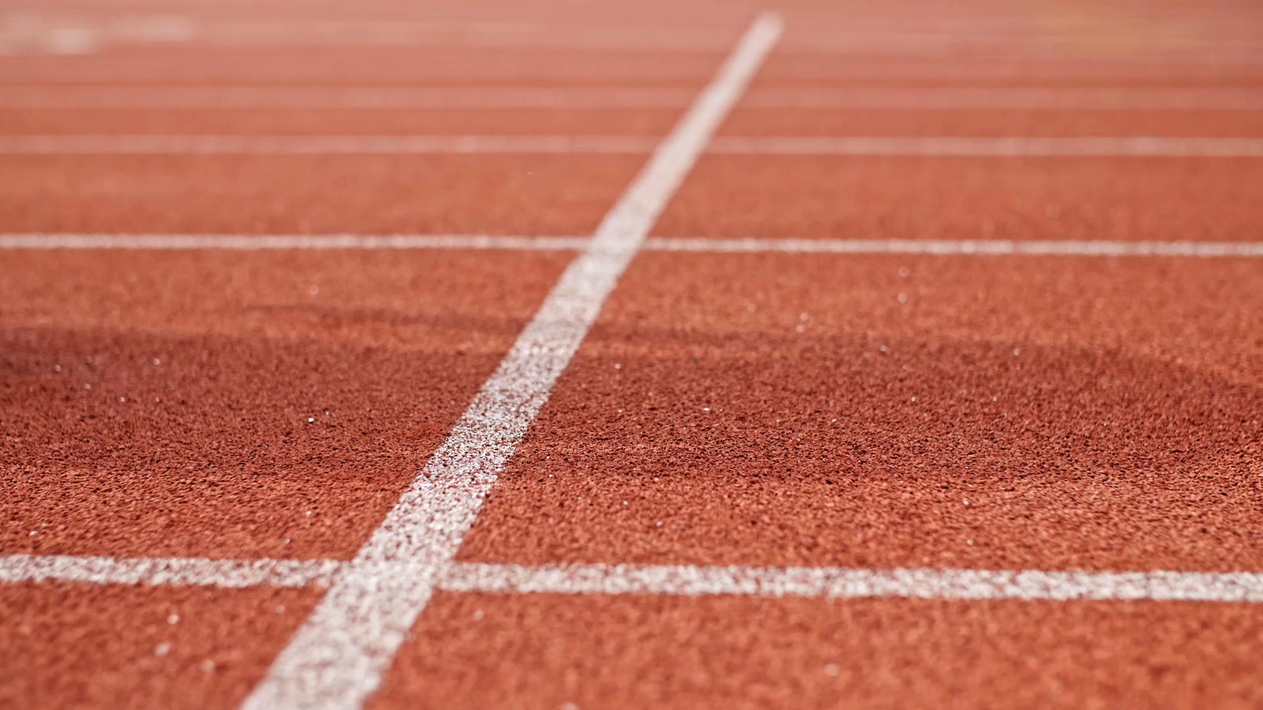
Variance in Athletic Standards over Time
By Matthew Oliver and Jackson Almaden

Slide 2
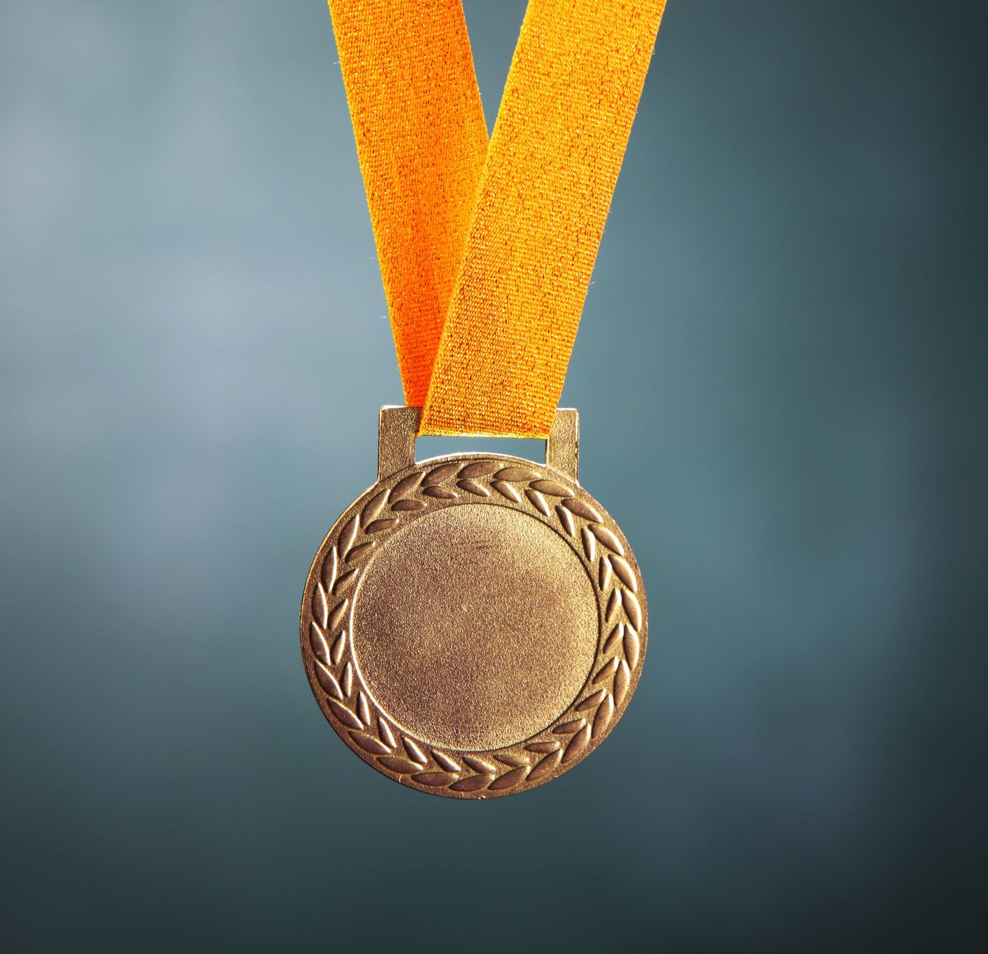
Athlete Builds to Medal Count
How much does athletic build affect performance
Use correlation between height/weight and medals
Do it on a sport by sport basis
Assign medals points

Slide 3
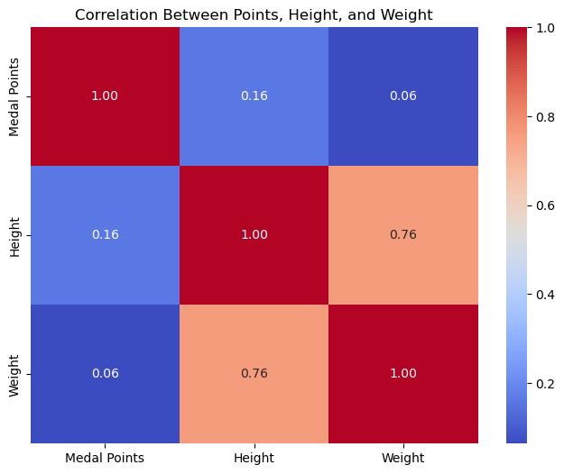

Slide 4
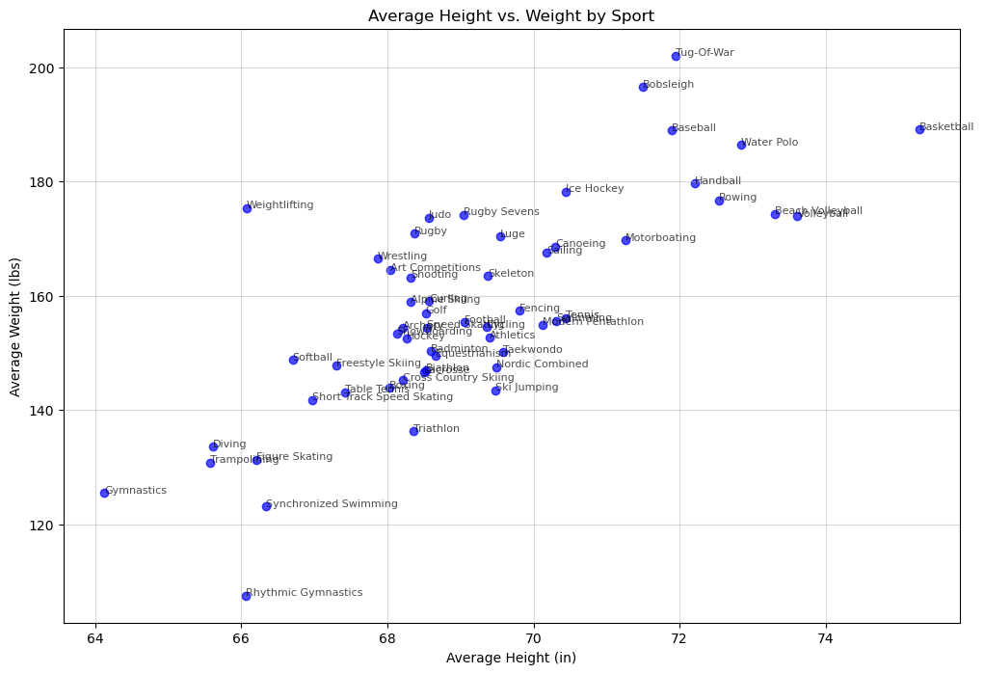

Slide 5
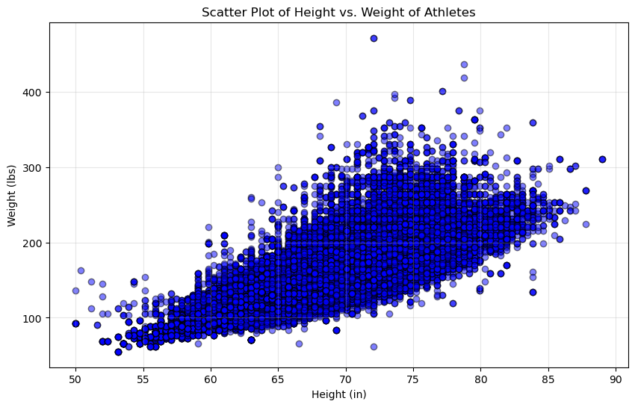

Slide 6
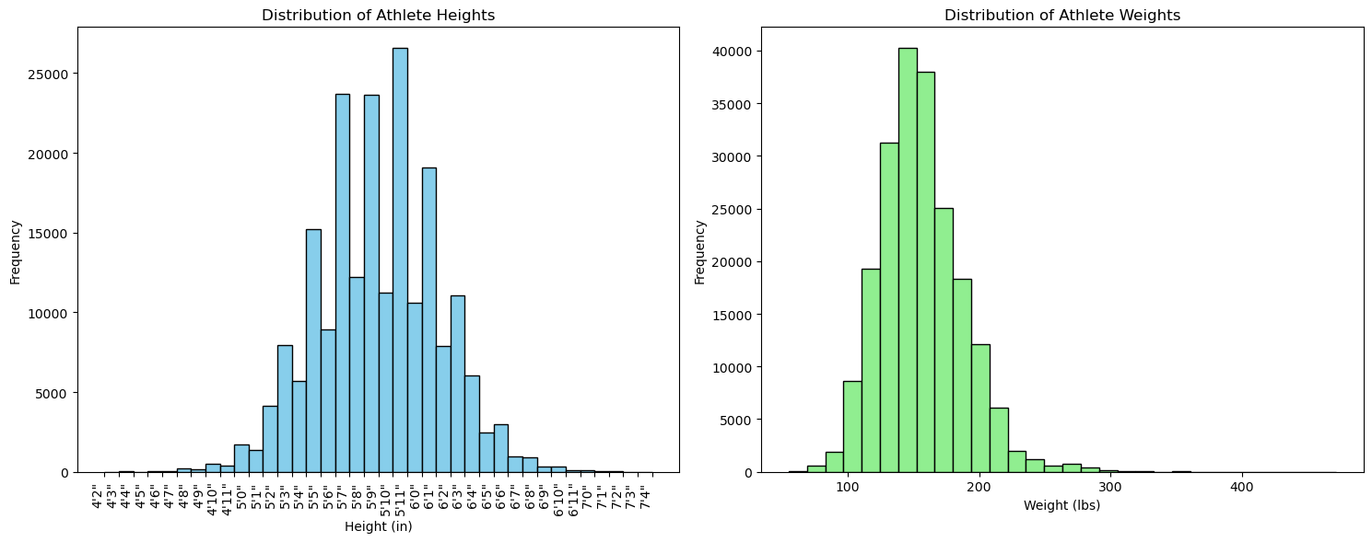

Slide 7
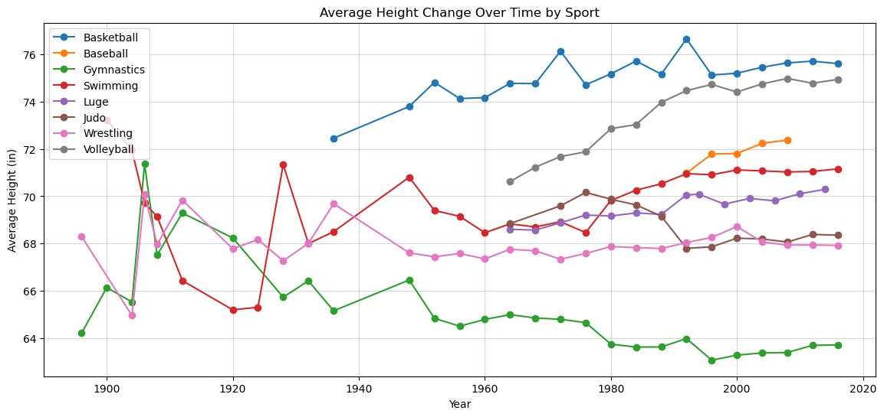
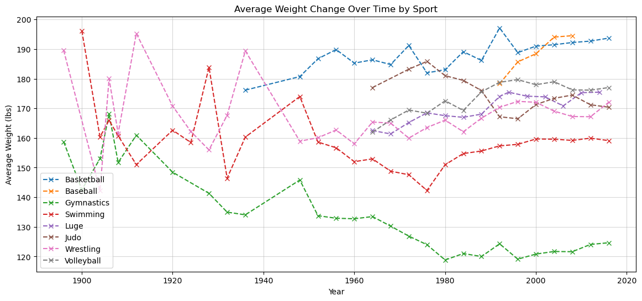

Slide 8
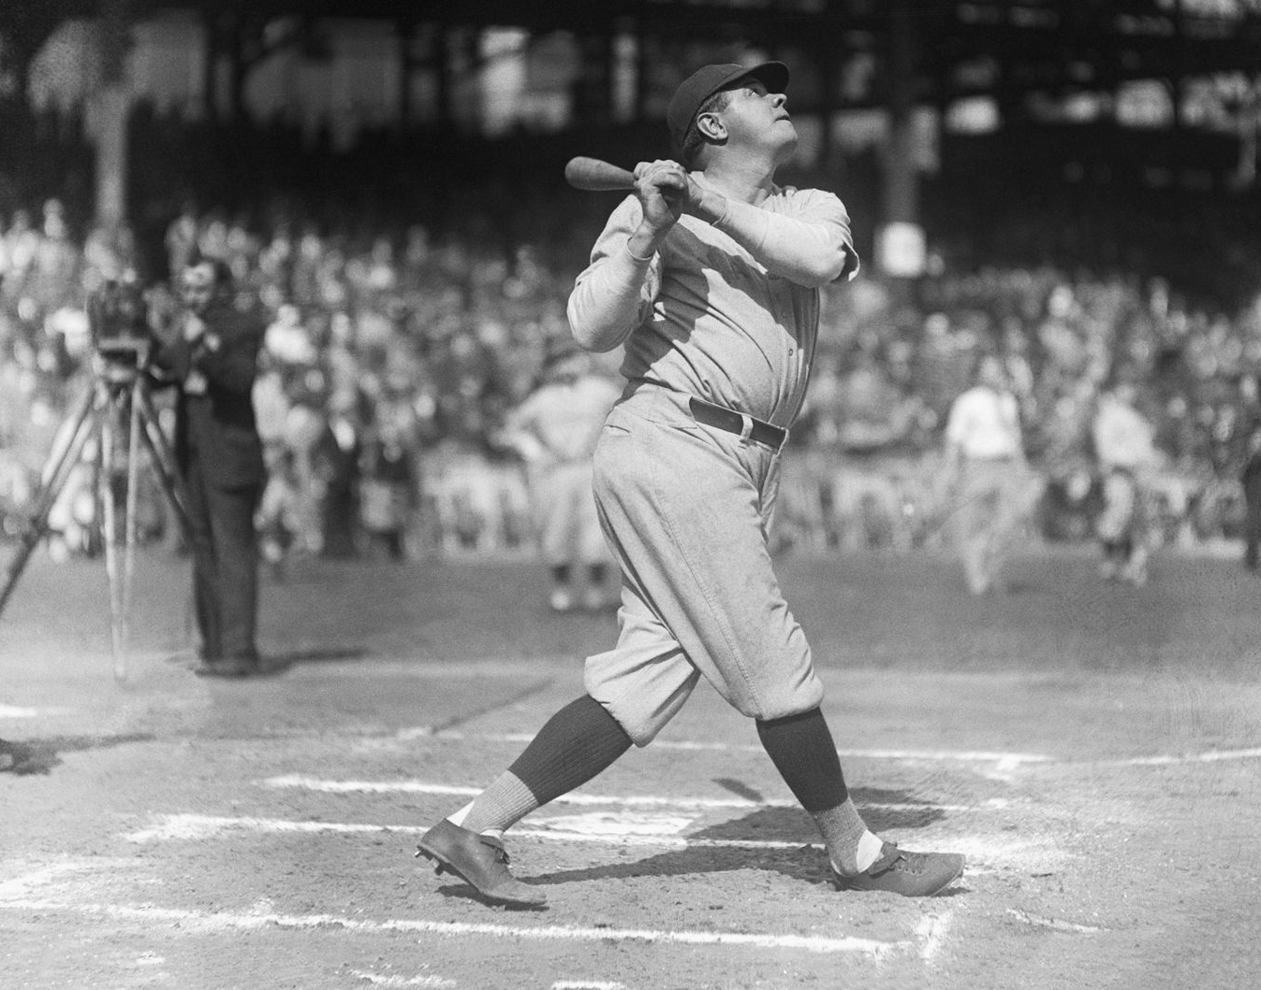
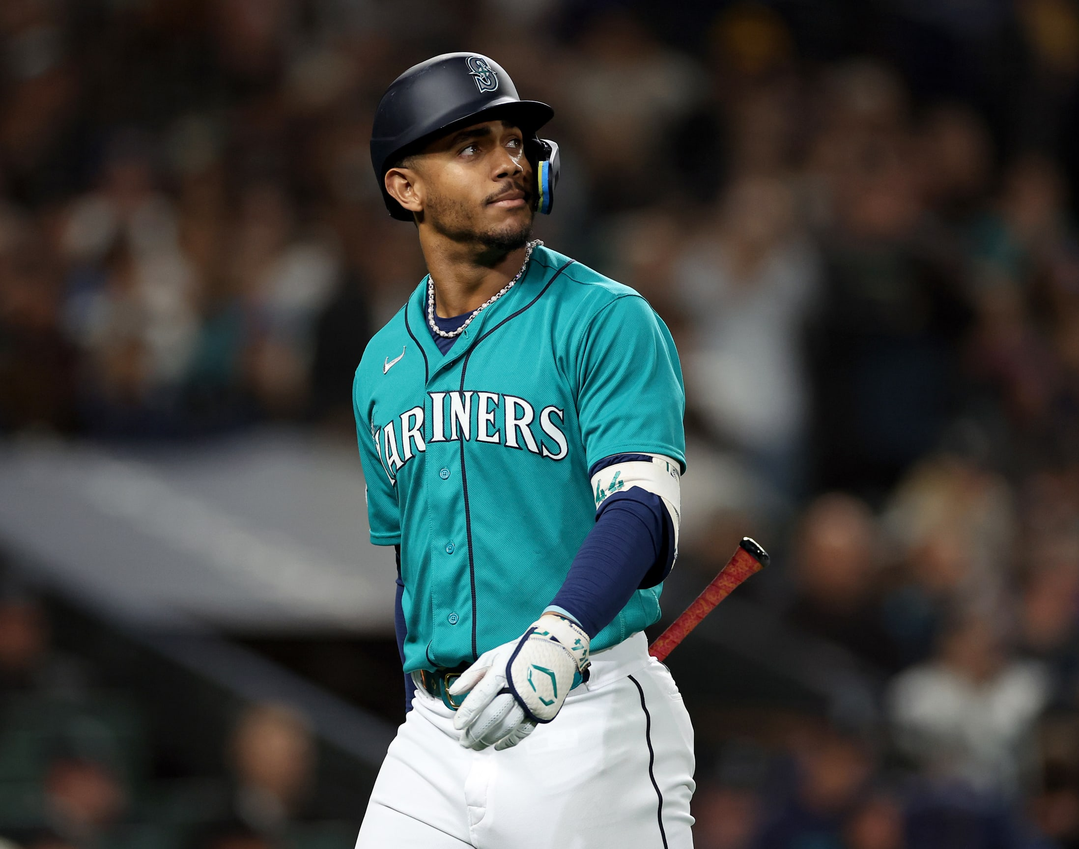
Modernization

Slide 9
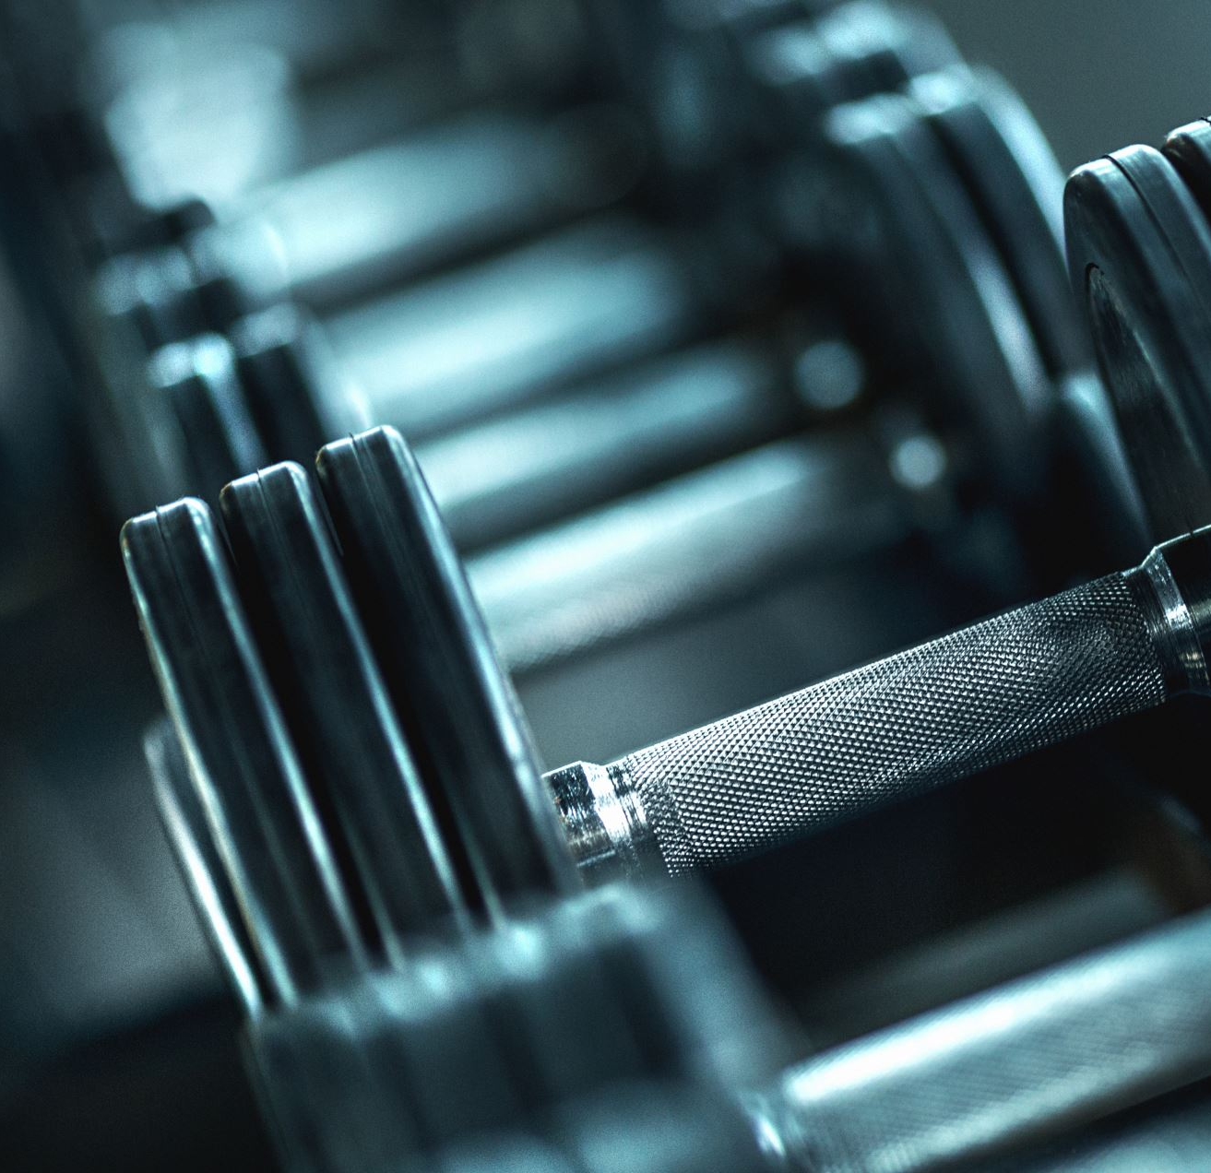
Athletic Standards have Increased
There is much less variance in athletic builds
Advancements in Sports Medicine and Nutrition
Athletes have optimized

Slide 10
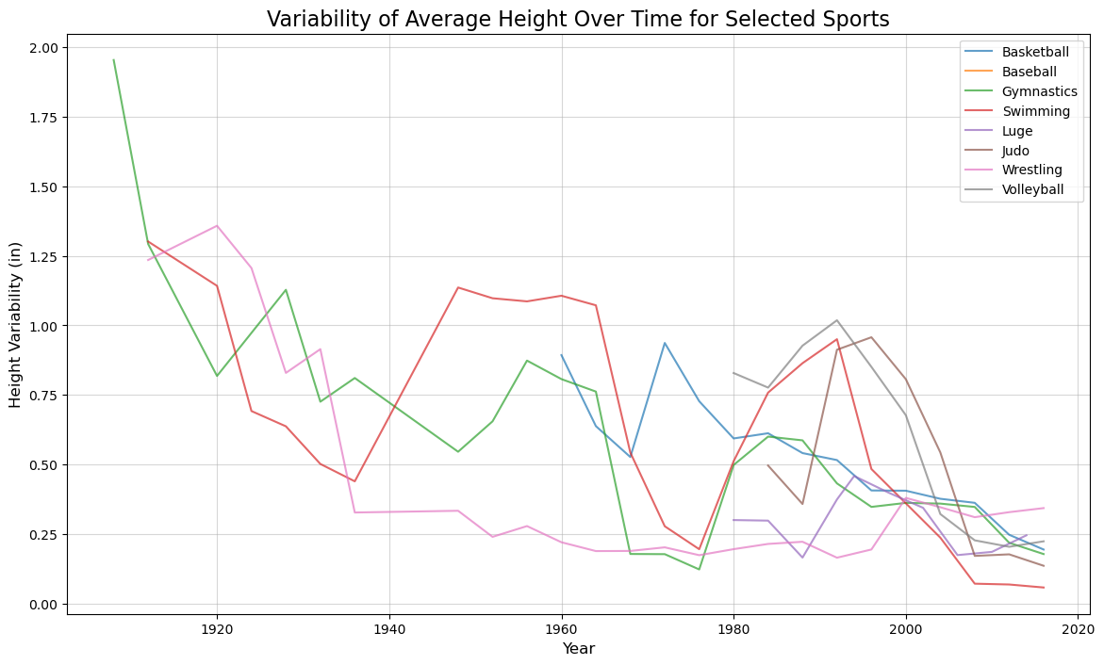
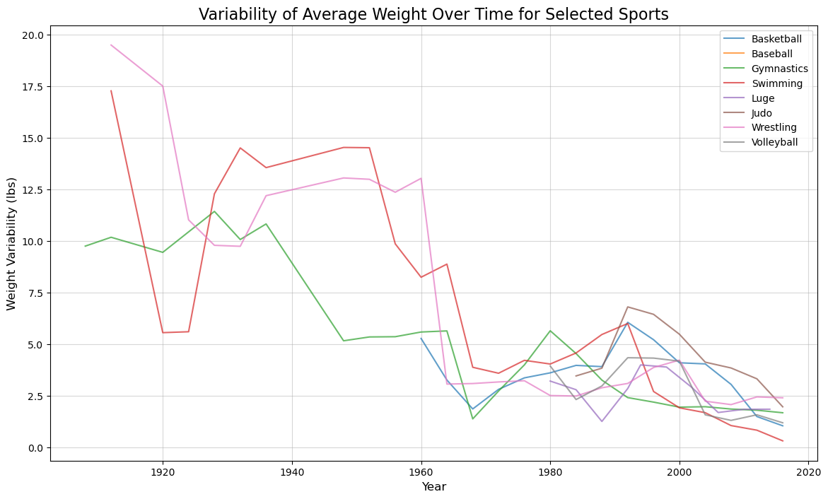

Slide 11
Next Steps
Get event data
Look at performance over time
Has that started to plateau
Have we reached our athletic peak?

Slide 12
